Slide 1
API Security

Slide 2
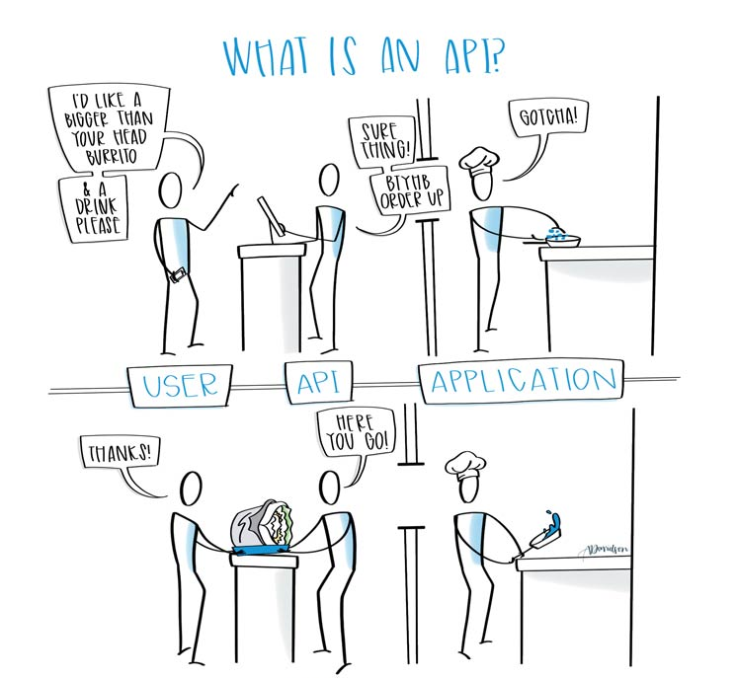
#API Era

Slide 3
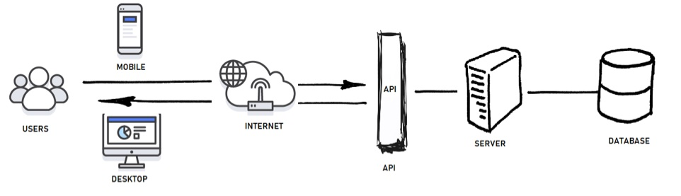
Everything Starts with a thought!
API became more business term than technical.
In an API-centric system, architecture is paramount.
Make sure what's the goal to be achieved in long run.

Slide 4
Brick by Brick
Built-in security than bolt-in security
Than depending on OWASP go extra mile
Layer the architecture.
Coupling the similar API’s
Zero trust on private API’s
Be clear on who can access what or maybe when.(Do Not be lethargic on this)

Slide 5
Brick by Brick
Decouple system at architecture level
Use API Gateways/Management Solutions
Understand what are the responsibilities handled by the provider of API Gateway (Cloud Based) and the user.
Usage of query language such as GraphQL to serve what quests.
Complexity Delayed is complexity multiplied.

Slide 6
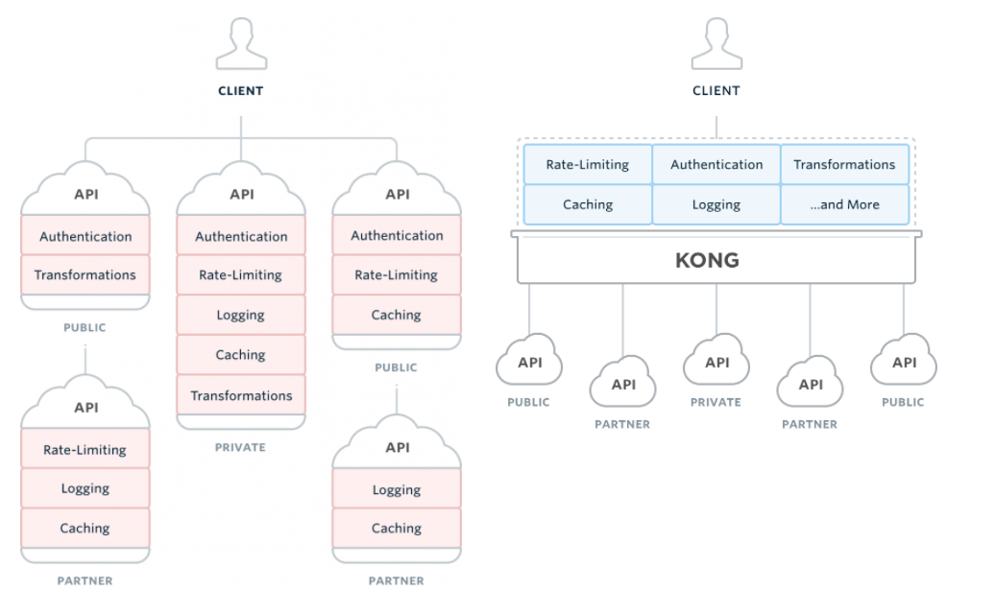
Courtesy: source: https://getkong.org/)

Slide 7
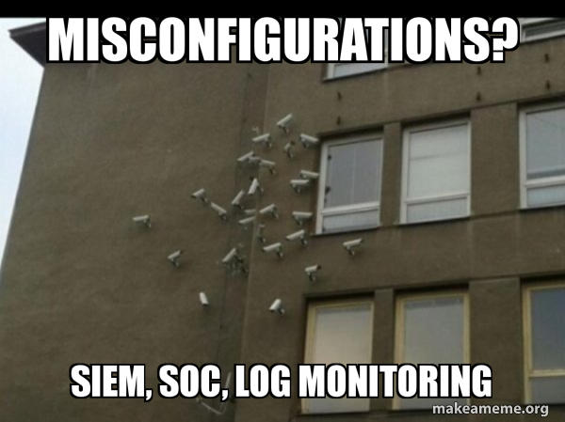
Lookout what you built
Logging AND Monitoring (Goes hand-in hand,
treat them a depended process and procedure)
Tools and procedures are in vain,
if not monitored.
Know the ideal places to logging.
Do not overwhelm with just any data
(know what to log and what not to log).
Avoiding misconfigurations.

Slide 8
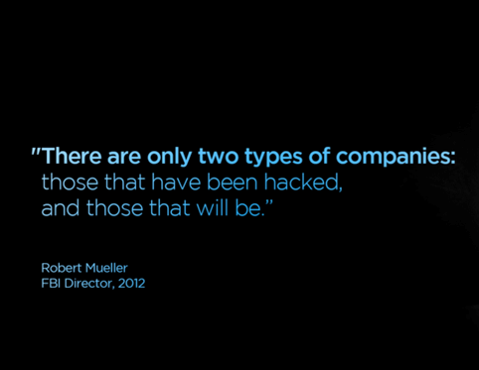

Slide 9

Thank You
Now let’s converse

